Slide 1
Classification
Chih-Sheng (Tommy) Huang
Chih.sheng.huang821@gmail.com

Slide 2
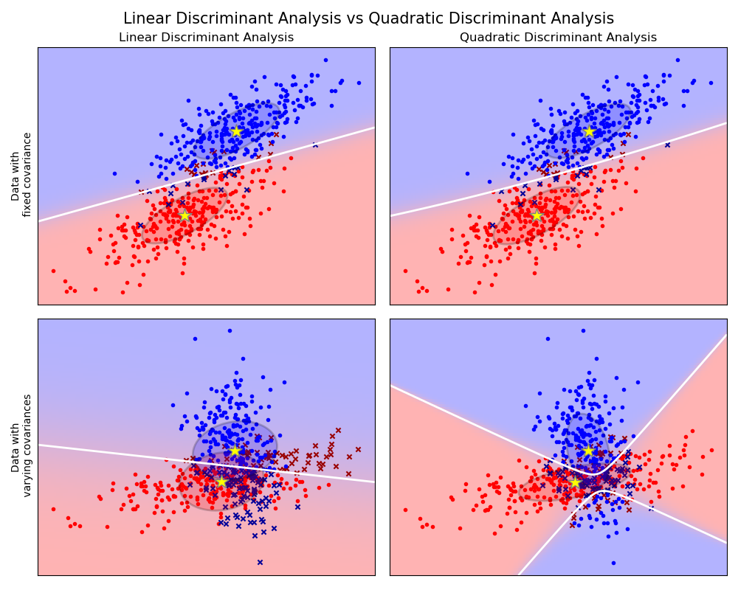
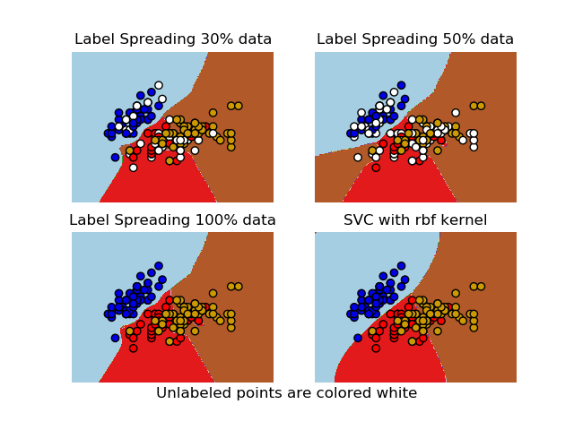
Classification
Identifying to which category an object belongs to.
Logistic Regression
Support Vector Machine
Nearest neighbors
Random forest
Neural Network

Slide 3

Classification
A Very simple classification problem
“How to classify {male or female} by a measured feature (body fat)?”
Collected data (body fat(%))
Female:{22, 25, 30, 33, 35}
Male:{ 10, 15, 20, 25, 30}

Slide 4
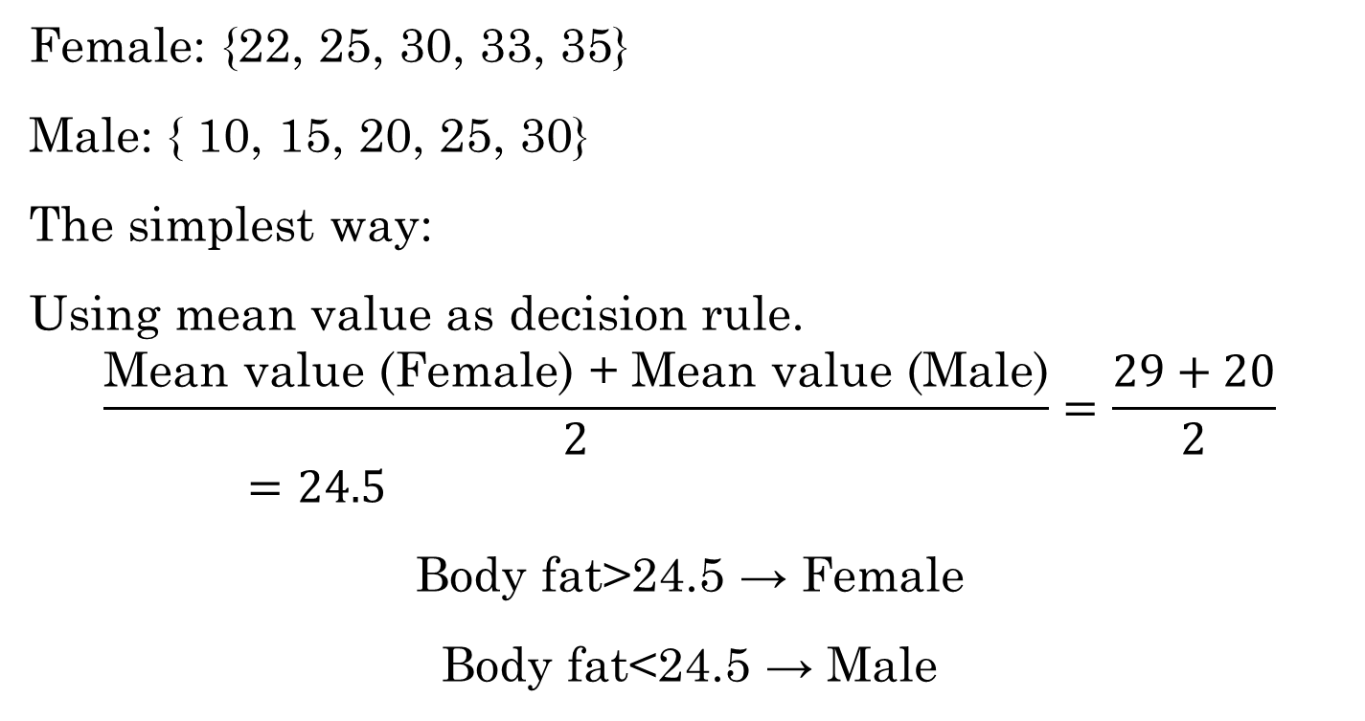
Classification
Female: {22, 25, 30, 33, 35}
Male: { 10, 15, 20, 25, 30}
The simplest way:
Using mean value as decision rule.
$$\frac{\text{Mean} \text{value}\text{ (}\text{Female}\text{) + }\text{Mean} \text{value}\text{ (}\text{Male}\text{)}}{2}=\frac{29+20}{2}=24.5$$
Body fat>24.5 → Female
Body fat<24.5 → Male

Slide 5
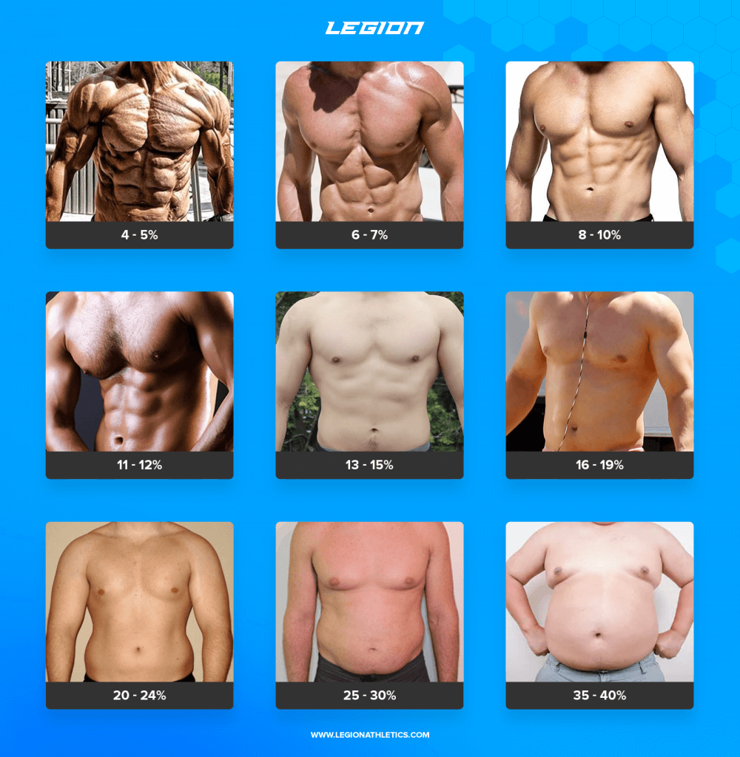
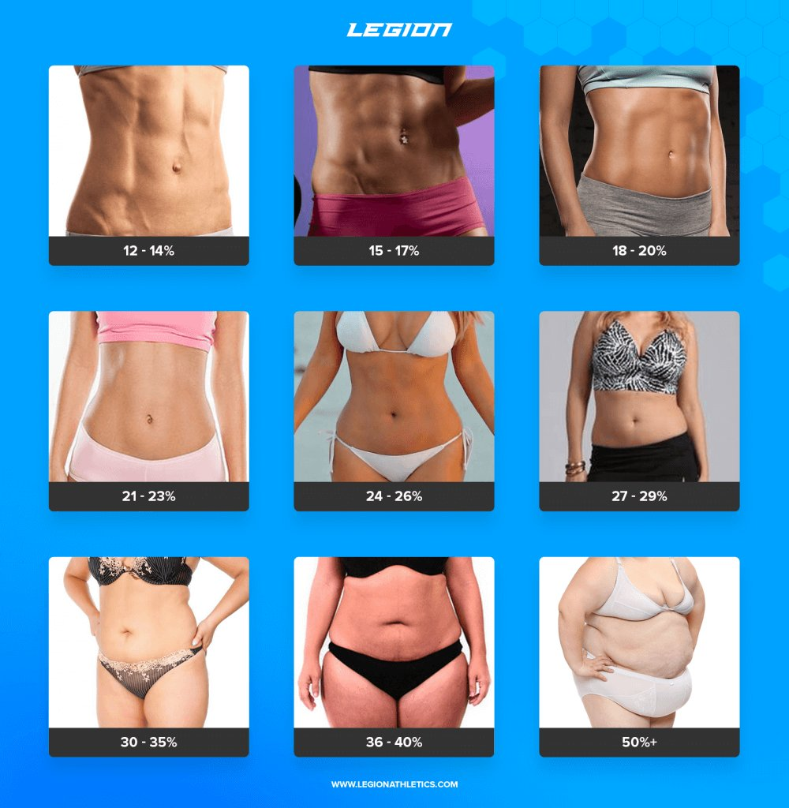
Body fat

Slide 6
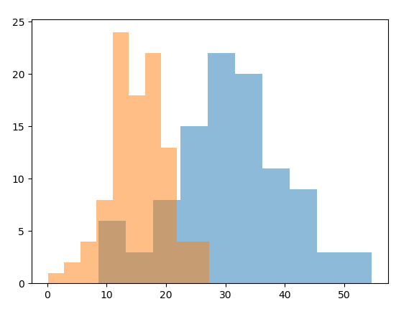

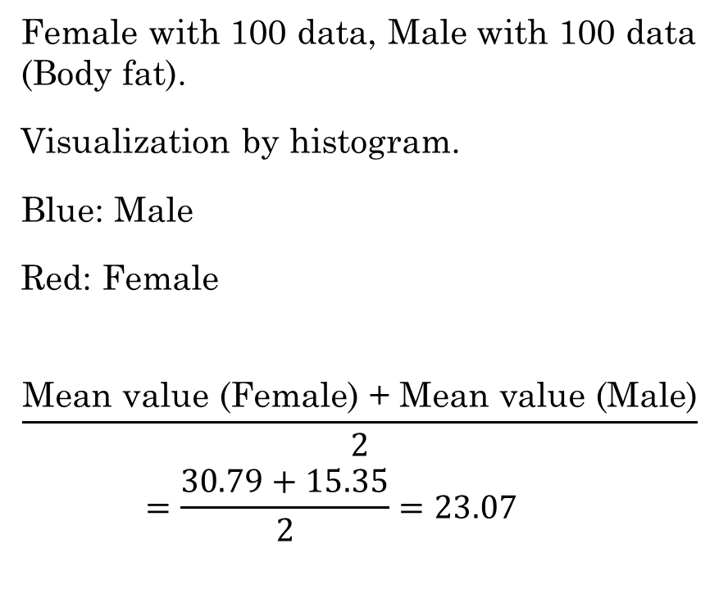
Classification
Female with 100 data, Male with 100 data (Body fat).
Visualization by histogram.
Blue: Male
Red: Female
$$\frac{\text{Mean} \text{value}\text{ (}\text{Female}\text{) + }\text{Mean} \text{value}\text{ (}\text{Male}\text{)}}{2}=\frac{30.79+15.35}{2}=23.07$$
count
Body fat
You Just learn a classification algorithm
$$23.07$$

Slide 7
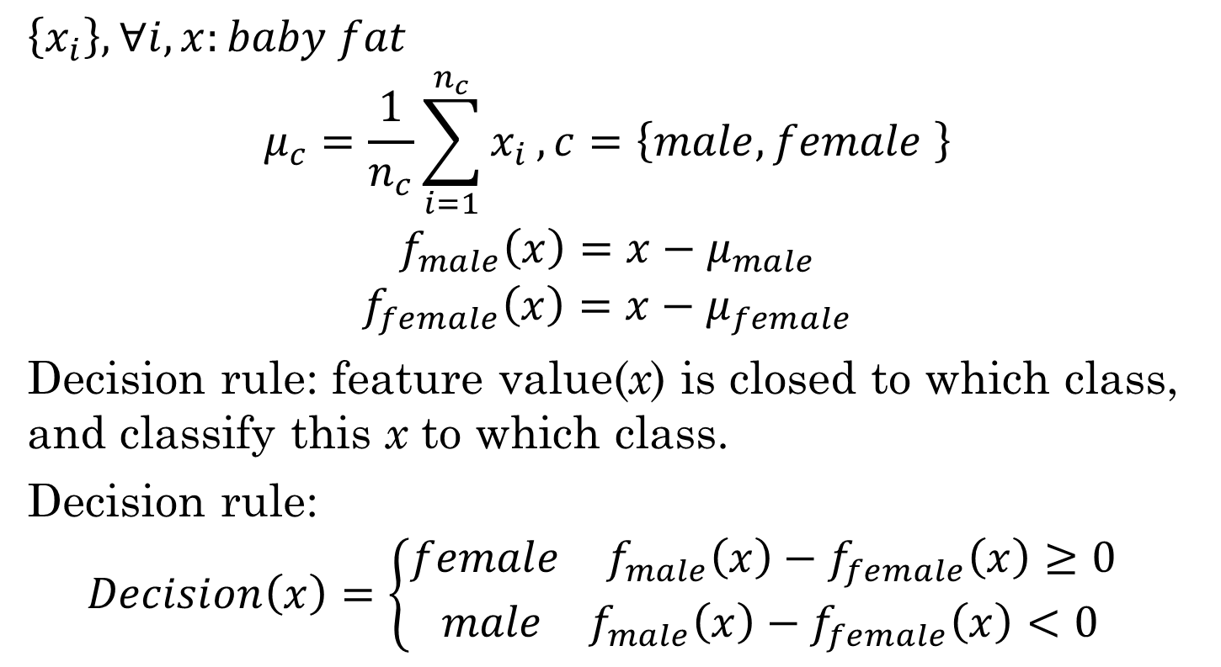
Classification
$$\left\{x_{i}\right\}, ∀i, x:baby fat$$
$$μ_{c}=\frac{1}{n_{c}}\sum_{i=1}^{n_{c}}{x_{i}}, c=\left\{male,female \right\}$$
$$f_{male}\left(x\right)=x−μ_{male}$$
$$f_{female}\left(x\right)=x−μ_{female}$$
Decision rule: feature value(x) is closed to which class, and classify this x to which class.
Decision rule:
$$Decision\left(x\right)=\left\{\begin{aligned}\begin{matrix}female & f_{male}\left(x\right)−f_{female}\left(x\right)≥0 \end{matrix} \\ \begin{matrix}male & f_{male}\left(x\right)−f_{female}\left(x\right)<0\end{matrix}\end{aligned}\right.$$

Slide 8
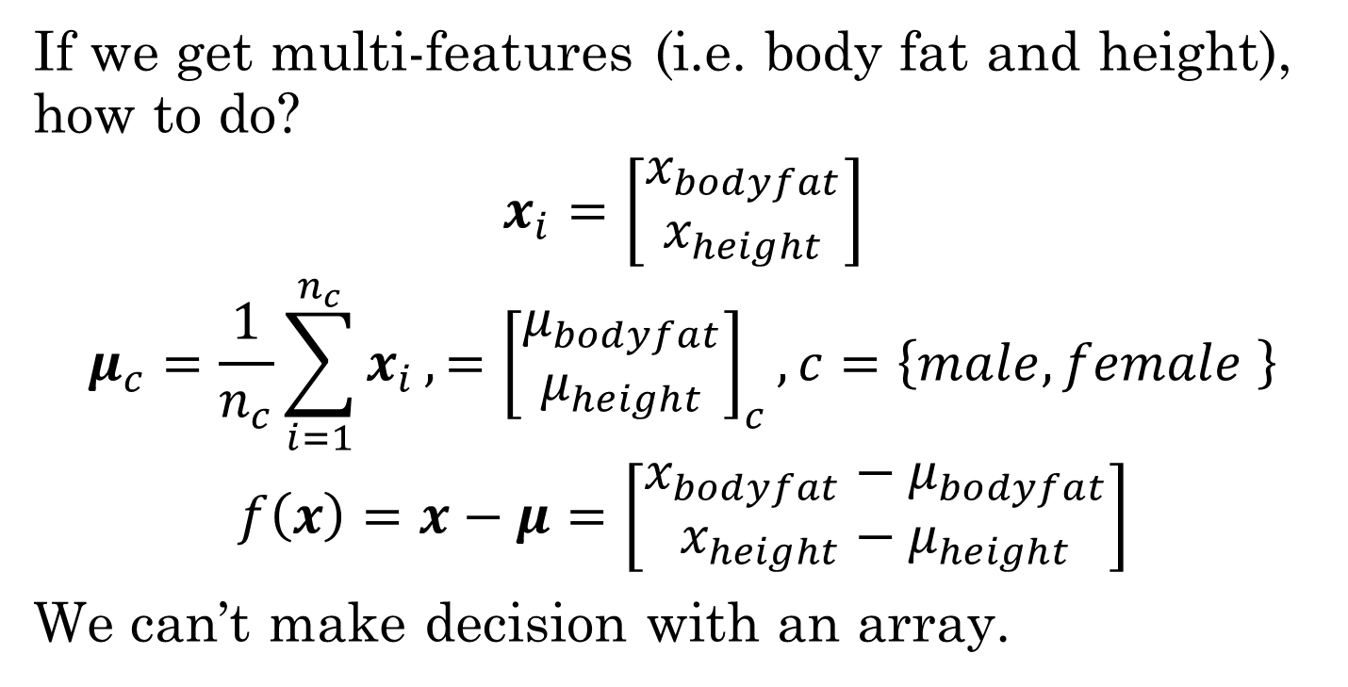
Classification
If we get multi-features (i.e. body fat and height), how to do?
$$x_{i}=\left[\begin{matrix}x_{bodyfat} \\ x_{height}\end{matrix}\right]$$
$$μ_{c}=\frac{1}{n_{c}}\sum_{i=1}^{n_{c}}{x_{i}},={\left[\begin{matrix}μ_{bodyfat} \\ μ_{height}\end{matrix}\right]}_{c}, c=\left\{male,female \right\}$$
$$f\left(x\right)=x−μ=\left[\begin{matrix}x_{bodyfat}−μ_{bodyfat} \\ x_{height}−μ_{height}\end{matrix}\right]$$
We can’t make decision with an array.

Slide 9
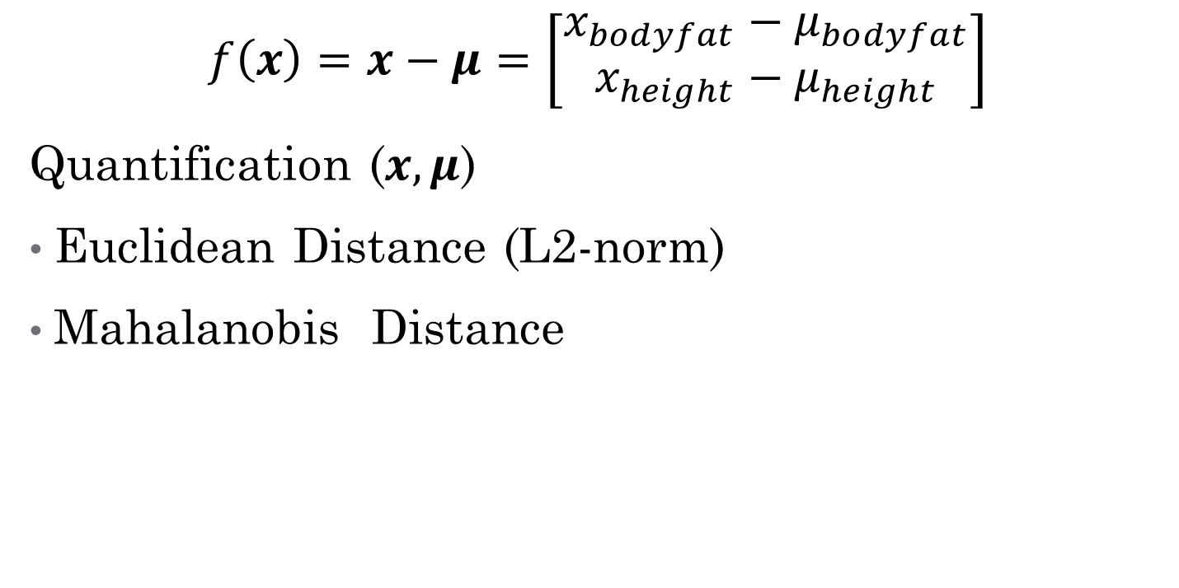
Classification
$$f\left(x\right)=x−μ=\left[\begin{matrix}x_{bodyfat}−μ_{bodyfat} \\ x_{height}−μ_{height}\end{matrix}\right]$$
Quantification ($x, μ$)
Euclidean Distance (L2-norm)
Mahalanobis Distance

Slide 10
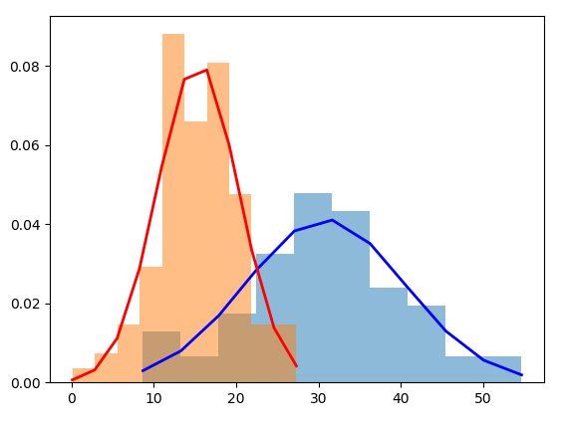

Likelihood function
We can assume the histogram (density) is a Gaussian (normal)-like distribution.
That means
$$x_{male}\sim N(μ_{male},σ_{male})$$
$$x_{female}\sim N(μ_{female},σ_{female})$$
$$f\left(x\left|μ,\right.σ\right)=\frac{1}{\sqrt{2π}σ}e^{−\frac{{(x−μ)}^{2}}{{2σ}^{2}}}$$

Slide 11
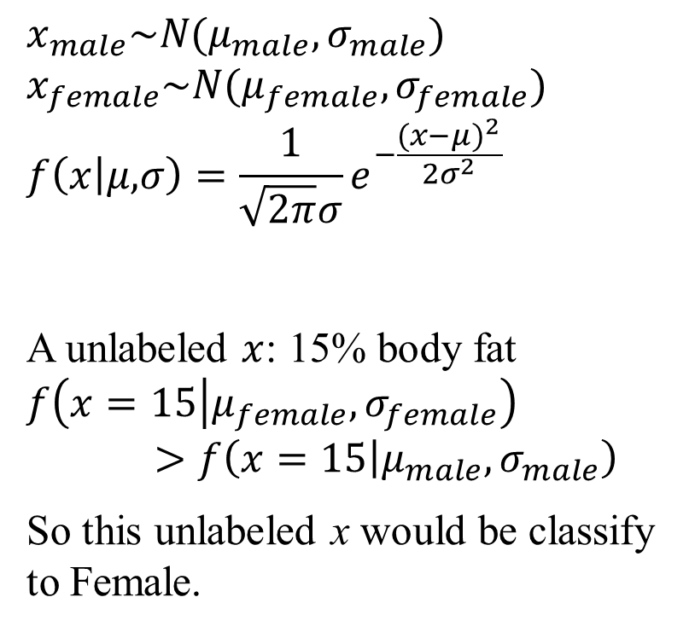
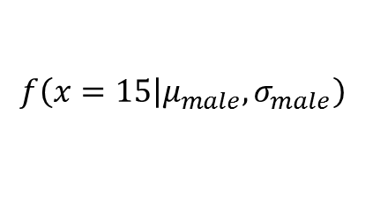

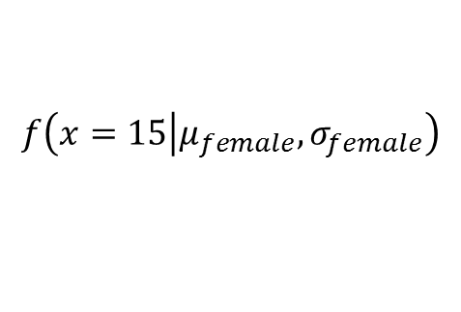
Likelihood function
$$x_{male}\sim N(μ_{male},σ_{male})$$
$$x_{female}\sim N(μ_{female},σ_{female})$$
$$f\left(x\left|μ,\right.σ\right)=\frac{1}{\sqrt{2π}σ}e^{−\frac{{(x−μ)}^{2}}{{2σ}^{2}}}$$
A unlabeled $x$: 15% body fat
$$f\left(x=15\left|μ_{female},σ_{female}\right.\right)>f\left(x=15\left|μ_{male},σ_{male}\right.\right)$$
So this unlabeled x would be classify to Female.
$$f\left(x=15\left|μ_{female},σ_{female}\right.\right)$$
$$f\left(x=15\left|μ_{male},σ_{male}\right.\right)$$
$$x=15$$
Notes:
$$Decision\left(x\right)=\left\{\begin{aligned}\begin{matrix}female & f\left(x\left|μ_{female},σ_{female}\right.\right)≥f\left(x\left|μ_{male},σ_{male}\right.\right) \end{matrix} \\ \begin{matrix}male & f\left(x\left|μ_{female},σ_{female}\right.\right)<f\left(x\left|μ_{male},σ_{male}\right.\right)\end{matrix}\end{aligned}\right.$$

Slide 12
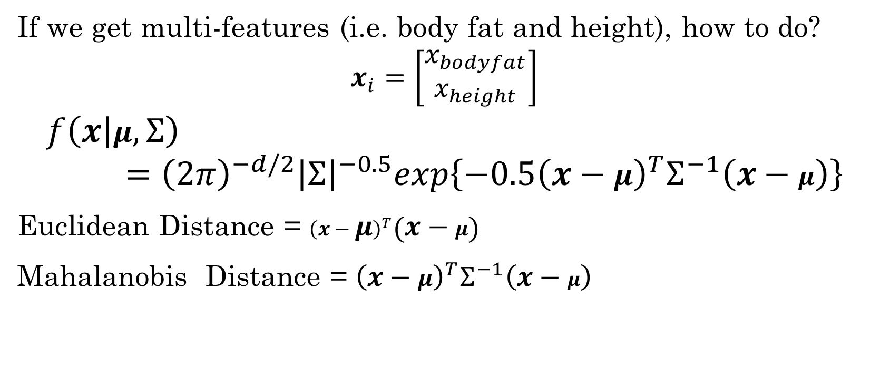
Likelihood function
If we get multi-features (i.e. body fat and height), how to do?
$$x_{i}=\left[\begin{matrix}x_{bodyfat} \\ x_{height}\end{matrix}\right]$$
$$f\left(x\left|μ\right.,Σ\right)={\left(2π\right)}^{−d/2}{\left|Σ\right|}^{−0.5}exp\left\{−0.5{\left(x−μ\right)}^{T}Σ^{−1}\left(x−μ\right)\right\}$$
Euclidean Distance = ${\left(x−μ\right)}^{T}\left(x−μ\right)$
Mahalanobis Distance = ${\left(x−μ\right)}^{T}Σ^{−1}\left(x−μ\right)$

Slide 13
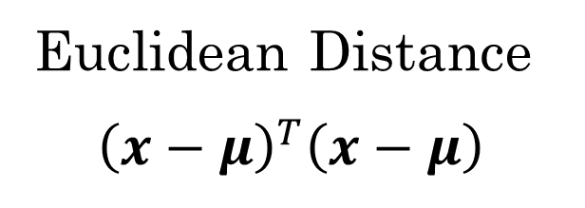
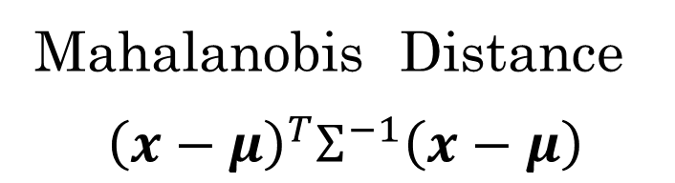
Distance
Euclidean Distance
${\left(x−μ\right)}^{T}\left(x−μ\right)$
Mahalanobis Distance
${\left(x−μ\right)}^{T}Σ^{−1}\left(x−μ\right)$
d1
d1
d2
d2
d1 = d2
d1 = d2

Slide 14
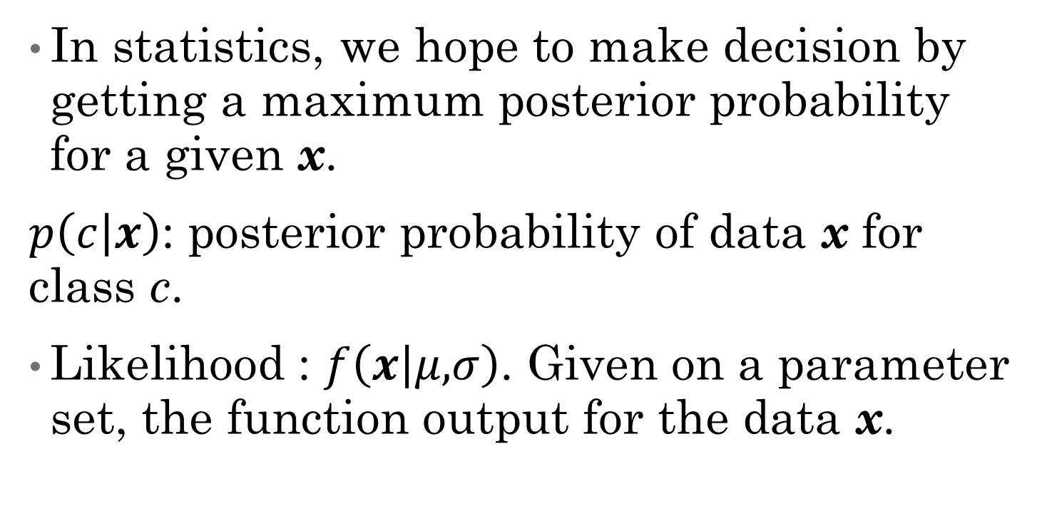
Maximum a posterior (MAP)
In statistics, we hope to make decision by getting a maximum posterior probability for a given x.
$p\left(c\left|x\right.\right)$: posterior probability of data x for class c.
Likelihood : $f\left(x\left|μ,\right.σ\right)$. Given on a parameter set, the function output for the data x.
Notes:
Likelihood is not probability, the area under their curves does not have to add up to 1.
Posterior probability must be.

Slide 15
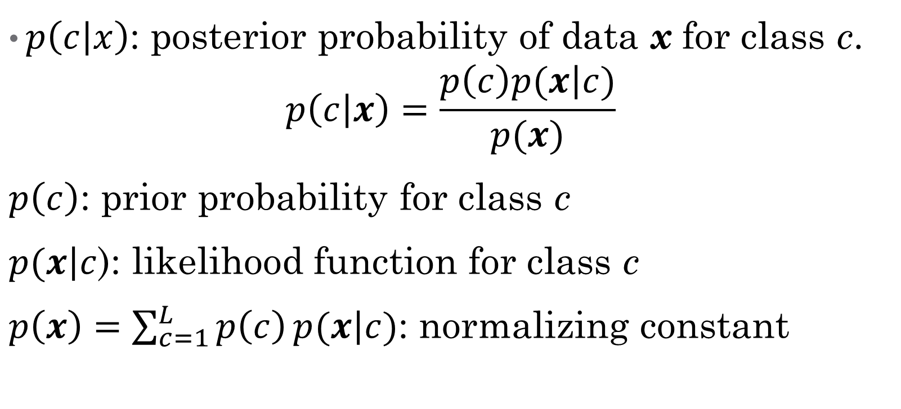
Maximum a posterior (MAP)
$p\left(c\left|x\right.\right)$: posterior probability of data x for class c.
$$p\left(c\left|x\right.\right)=\frac{p\left(c\right)p(x\left|c\right.)}{p(x)}$$
$p\left(c\right)$: prior probability for class c
$p(x\left|c\right.$): likelihood function for class c
$p\left(x\right)=\sum_{c=1}^{L}{p\left(c\right)}p(x\left|c\right.)$: normalizing constant
Notes:
Bayes’Rule.

Slide 16
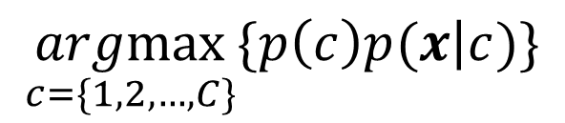
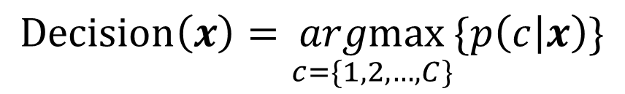
Maximum a posterior (MAP)
How to make decision?
By checking the posterior probability for all class.
$$Decision\left(x\right)=\underset{c=\{1,2,…,C\}}{argmax}{\{p\left(c\left|x\right.\right)\}}$$
$$\underset{c=\{1,2,…,C\}}{argmax}{\{p\left(c\right)p(x\left|c\right.)\}}$$

Slide 17



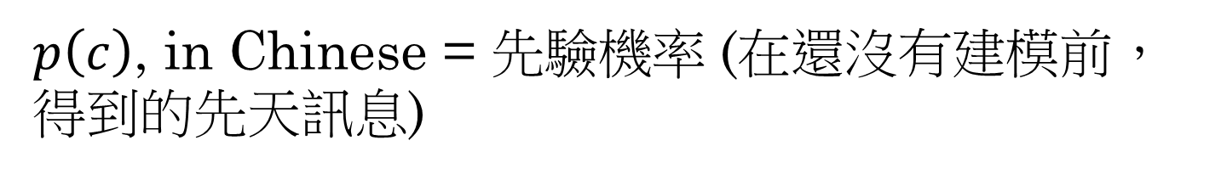
Prior probability
$p\left(c\right)$, in Chinese = 先驗機率 (在還沒有建模前，得到的先天訊息)
Female
75%
Gender?
Sample a people.
Male
25%
Male : Female = 25: 75
Notes:
https://www.gettyimages.hk/detail/%E6%96%B0%E8%81%9E%E7%85%A7%E7%89%87/male-and-female-customers-browse-the-shopping-aisles-at-the-%E6%96%B0%E8%81%9E%E7%85%A7%E7%89%87/486212566

Slide 18
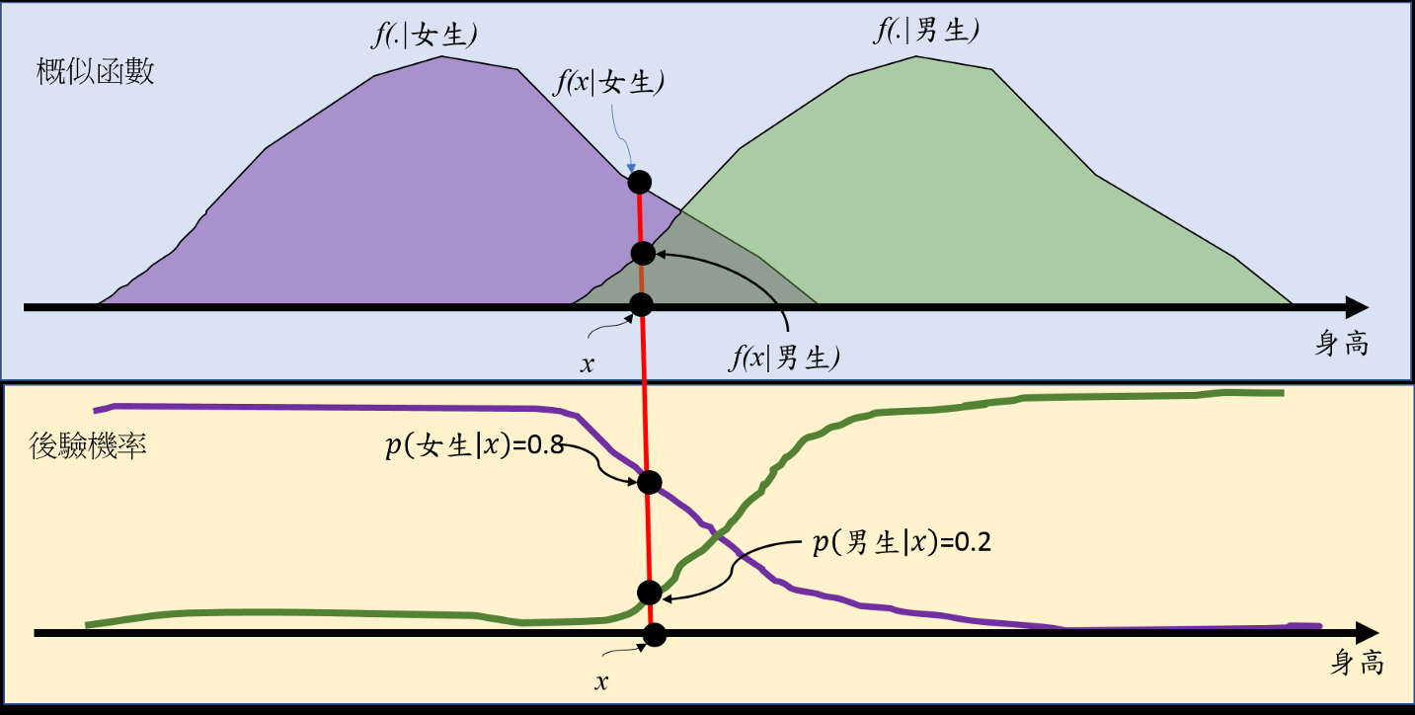
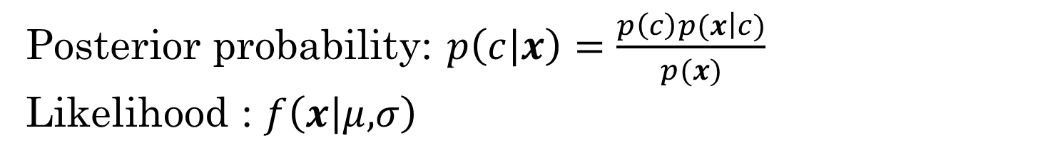
Maximum a posterior (MAP)
Posterior probability: $p\left(c\left|x\right.\right)=\frac{p\left(c\right)p(x\left|c\right.)}{p(x)}$
$$\text{Likelihood}\text{ : }f\left(x\left|μ,\right.σ\right)$$
Likelihood function
Posterior probability

Slide 19
Maximum a posterior (MAP)
Decision rule:

Slide 20
MAP with Gaussian function
Gaussian function:
MAP:

Slide 21
MAP with Gaussian function
Gaussian function + MAP:

Slide 22
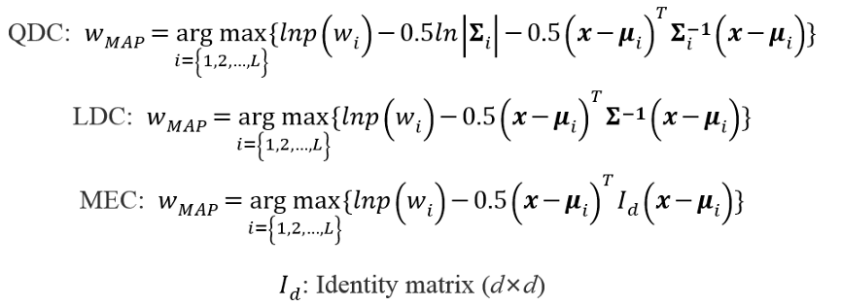
MAP with Gaussian function
The most important term of this formula is measuring the distance between x and center of distribution
Notes:
Gaussian classifier
linear discriminant classifier (LDC)
Quadratic density classifier (QDC)
Maximum-likelihood Classifier (MLC)
MEC(minimum Euclidean classifier)

Slide 23
Classification
We just learned model-based algorithm.
Model-based: data is assumed as normal distribution. (parameters: mean vector and covariance matrix)
Can we learn without model?
ANS: Yes. Nearest neighbors, SVM, neural network.

